Slide 1
INTRODUCTION TO OBJECT ORIENTED PROGRAMMING IN C#-Part2

Slide 2
Objective
Using Constructors
Default Constructor
Calling Constructor
Overloaded constructor
Method Overloading

Slide 3
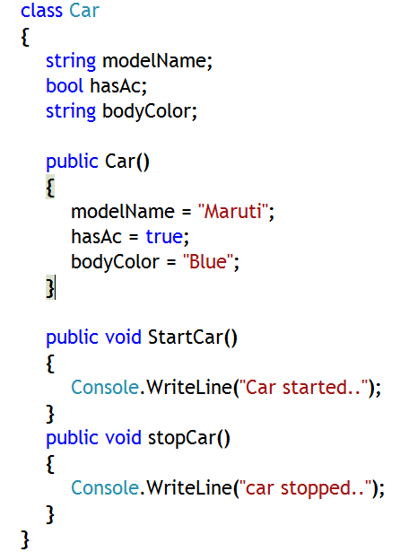
Constructor
A constructor is a special method that is called to initialize default values to data members (fields) of a class
It does not create object
Constructor’s name is same as that of the class.
Constructor does not return anything
Constructor

Slide 4
Default Constructor
Features of a default constructor
Public accessibility
Same name as the class
No return type—not even void
Expects no arguments
Initializes all fields to zero, false or null
Constructor Example:
class Date
{
public Date( )
{ ... }
}

Slide 5
Explicitly Providing the Default Constructor
Default constructor will be supplied by compiler
But, the default constructor might be inappropriate
If so, do not use it; write your own!
If you are providing default constructor, then compiler will not supply the default constructor
class Date
{
private int ccyy;
private int mm;
private int dd;
public Date( )
{
ccyy = 1970;
mm = 1;
dd = 1;
}
}

Slide 6
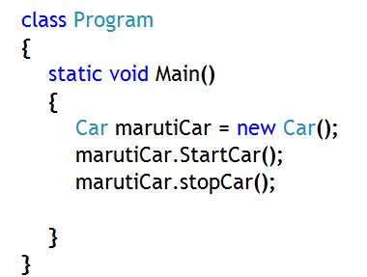
Calling Constructor
Initialize the object’s fields with default values by using a constructor
Use the name of the class followed by parentheses followed by ‘new’ keyword
As default value, zero is assigned to numerical fields (int, double, long etc.), null is assigned to reference types (string or any class variables) and false is assigned to boolean types
Calling the constructor

Slide 7
Method Overloading
It is an example of early binding or static polymorphism
Which method will be called that is decided during compile time
All the overloaded methods, with same name, are part of single class
Method signatures must be unique within a class
Signature definition makes the difference
Criteria for Signature Difference
Which Does Not Have An Impact On Signature?
No of Parameters
Data Type of Parameters
Position of Parameters
Name of parameter
Return type of method

Slide 8
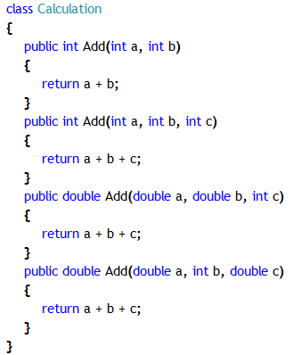
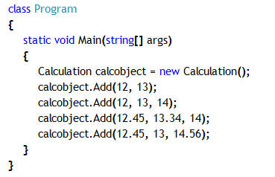
Declaring Overloaded Methods
Calculation is having four overloaded ‘Add’ methods with four different signatures
During method calls, each and every method call will be attached to proper overloaded method with the help of method signature

Slide 9
When to Use and When Not to
Consider using overloaded methods when:
You have similar methods that require different parameters
You want to add new functionality to existing code
Do not overuse because:
Hard to debug
Hard to maintain

Slide 10
Constructor Overloading
Constructors are methods and hence can be overloaded
Same scope, same name, different parameters
Allows objects to be initialized in different ways
WARNING
If you write a overloaded constructor for a class, the compiler does not create a default constructor
class Date
{
public Date( )
{ ... }
public Date(int year, int month, int day)
{ ... }
...
}
Default constructor
Overloaded constructor

Slide 11
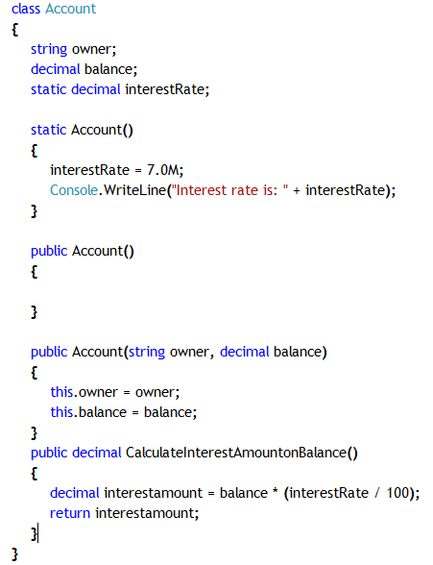
Example: Constructor Overloading
Static Constructor
Explicit Default Constructor
Overloaded Constructor

Slide 12
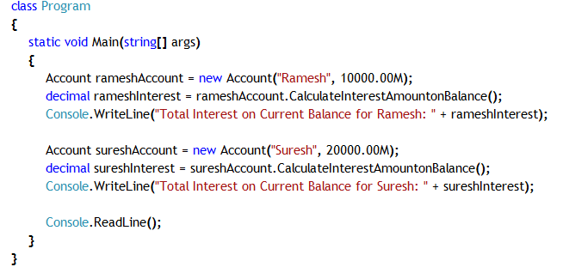
Example: Constructor Overloading
Calling Overloaded Constructor

Slide 13
Reference
For more information of constructors in C#, please visit the following link
http://msdn.microsoft.com/en-us/library/ms173115.aspx
http://www.codeproject.com/Articles/7011/An-Intro-to-Constructors-in-C
For more information on function/method overloading, please visit the following links
http://www.codeproject.com/Articles/17951/Function-Overloading
http://msdn.microsoft.com/en-us/library/vstudio/ms229029(v=vs.100).aspx
Notes:
Reference

